Slide 1
AI and 4D

Slide 2
Agenda
Intro/Disclaimer
Million dollar question
LLMs
Demos
4D product AI initiatives

Slide 3
Ricardo Mello (4D Sales – Vancouver Canada)
Bachelor's Degree in Computer Science in 1988-1992
Developer (12 years) – IT Manager (11 years)
Vax-VMS/RDB, dbase-clipper, Java-Oracle, Perl-Oracle, Perl-Multi, Javascript-multi
Sales (11 years)
AB InBev (Brazil) and currently at 4D (North America).

Slide 4
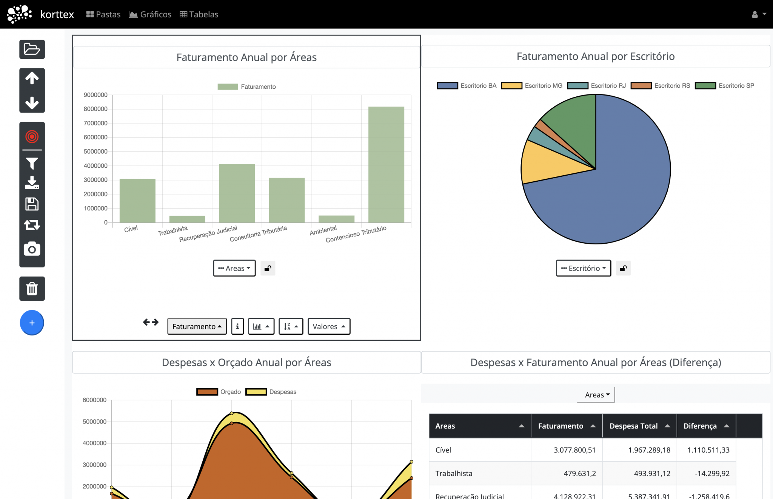
Disclaimer
No prior experience in building systems with 4D
How do I stay relevant in programming? a serverless BI system

Slide 5
How can LLMs be helpful to 4D systems?
That for me is …
The million-dollar question

Slide 6
AI ?
2023 Open source (llama)
HuggingFace
Attention is all you need
Hands on: RAGs, Vector Databases, post training..
Focus: Integrating LLMs into existing systems
Notes:
Ashish Vaswani => Attention (who, did what, to whom) attention headers => Transformers

Slide 7
LLM (great topics for the happy hour with Kirk)
2017 – Transformers Revolutionize AI
2018-2019 – Large-Scale LLMs Emerge
2020-2021 – LLM Explosion & Private Models Dominate
2022 – ChatGPT & Public AI Adoption
2023 – Open Source AI Gains Momentum (llama, BERT=>HuggingFace)
2024 – Specialization, Agents & Local LLMs/SLMs
Notes:
The focus shifts to fine-tuning, retrieval-augmented generation (RAG), and smaller, local models (e.g., Mistral, Phi-2, LLaMA 3).
Businesses move toward on-premise AI, ensuring privacy and control.

Slide 8
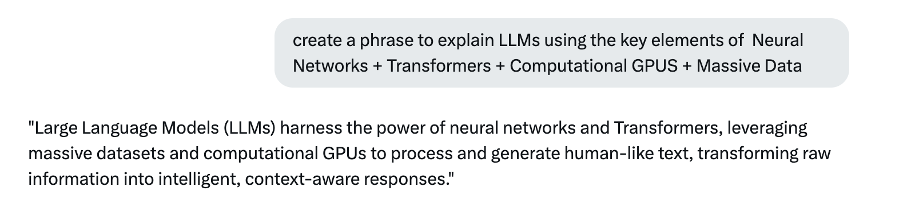
LLM
Neural Networks + Transformers + Computational GPUS + Massive Data
Notes:
Attention is all your need (context matter)
Transformers => by tokenizen (words, images) multiple times in parallel/matrix/algebra + Computational GPUS + massive data => unsupervised learning

Slide 9
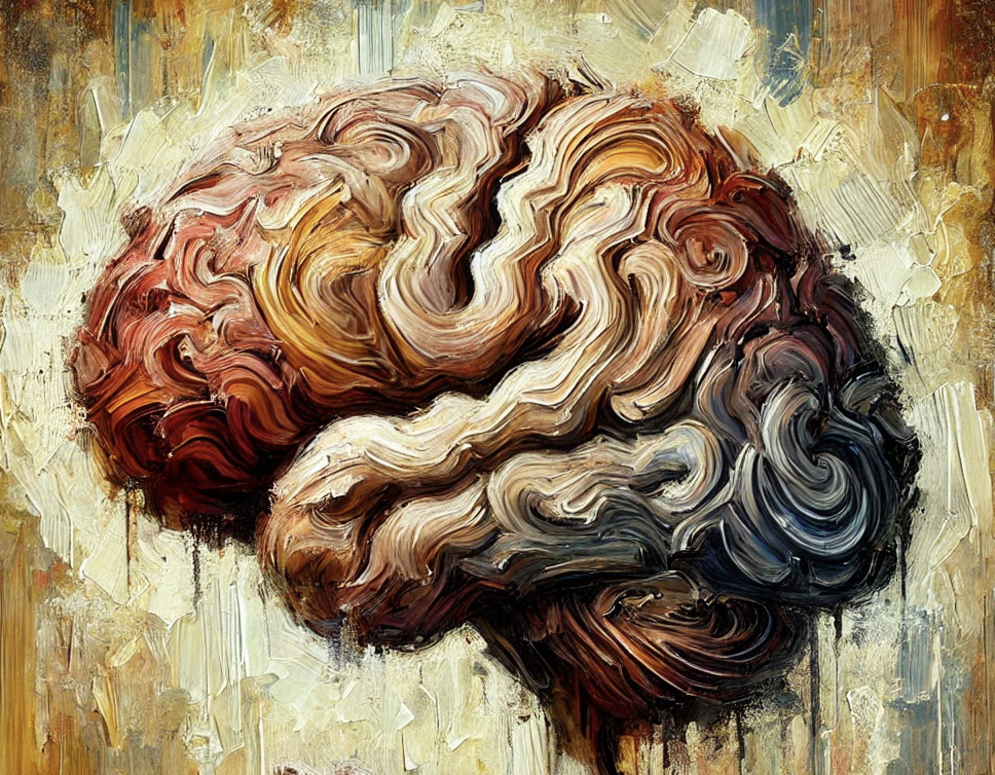

Slide 10
First Principles
LLMs understand language
LLMs can be taught
LLMs work with context
LLMs can be reasonably obedient if well guided

Slide 11
MsL (Microservice LLMs):
Use the LLM as a system component (not out but in)
Define communication layer (JSON)
Prompt the LLM communication and bizz rules
Receive JSON answers to be codified by 4D
Important Points
Minimize (sensitive) data sharing
Use a 3rd party (Groq, Chatgtp, Grok, Anthropic…) for performance
Actionable for the 4D community
Adaptable to your interface

Slide 12
1st Demo: 4D Invoicing system
4D US internal invoice system
Customers, Invoices, Reports …
This is a mature system running for +10 years
2nd Demo
Qodly

Slide 13
Next Talk
Data Privacy: No External calls to 3rd party companies
Open sourced LLM
Base LLM => New Training Data => Load Transformers/Pytorch => Retrain Data => Quantitize Qlora => New LLM with your data embedded.
Cost intensive

Slide 14
AI and the 4D 21 product (current efforts)
Product AI embedded
4D Write Pro AI
Qodly AI
AI configurations for LLMs integration
A 4D vector database
Demo (video) By David Azancot :
The main objective of this demo is to simplify image organization and retrieval by enabling users to add and tag images in just a few clicks.

